Slide 1
Project Portal
Daniel Card
February 9, 2015
CSCE470-Capstone

Slide 2
Project Overview
Create a web application that contains tools for project collaboration
Uses ASP.NET and C# for server side code
Uses HTML and JavaScript for client side code
Will require authentication to provide security

Slide 4
Map page
Display map of project area
Have the ability to display land record layers
Use existing DNR map services

Slide 5
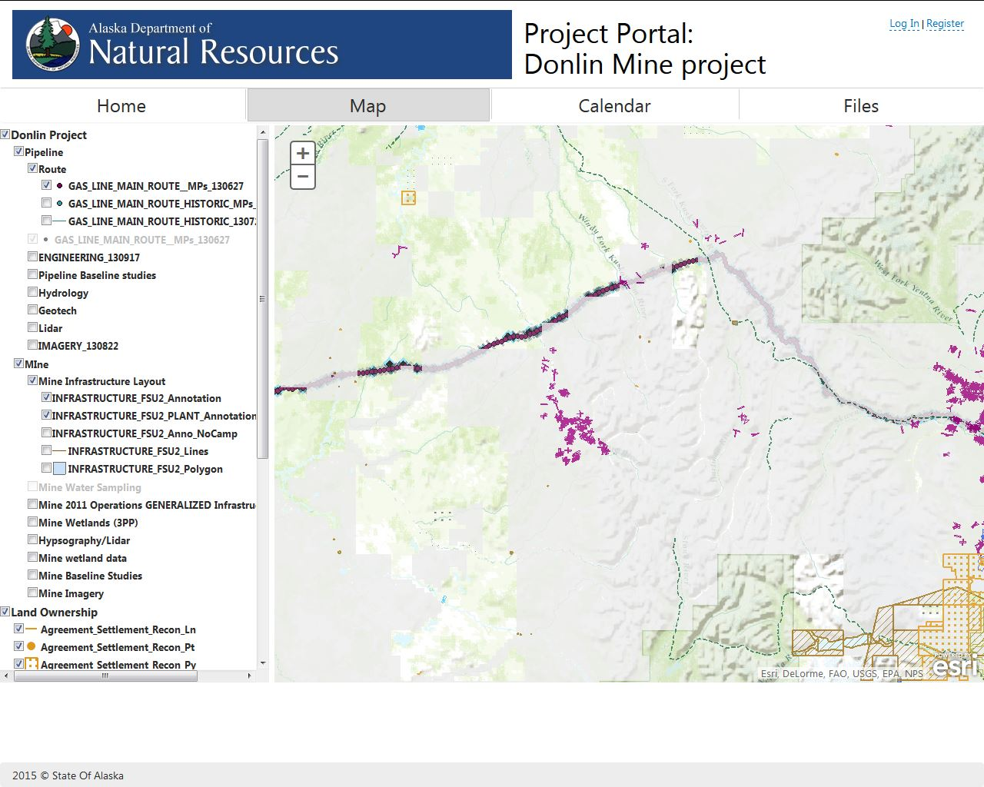

Slide 6
Calendar page
Have the ability to display project meetings and activities
Have the ability to create and update calendar appointments
Connect to a Microsoft Exchange server to store and retrieve data.

Slide 7
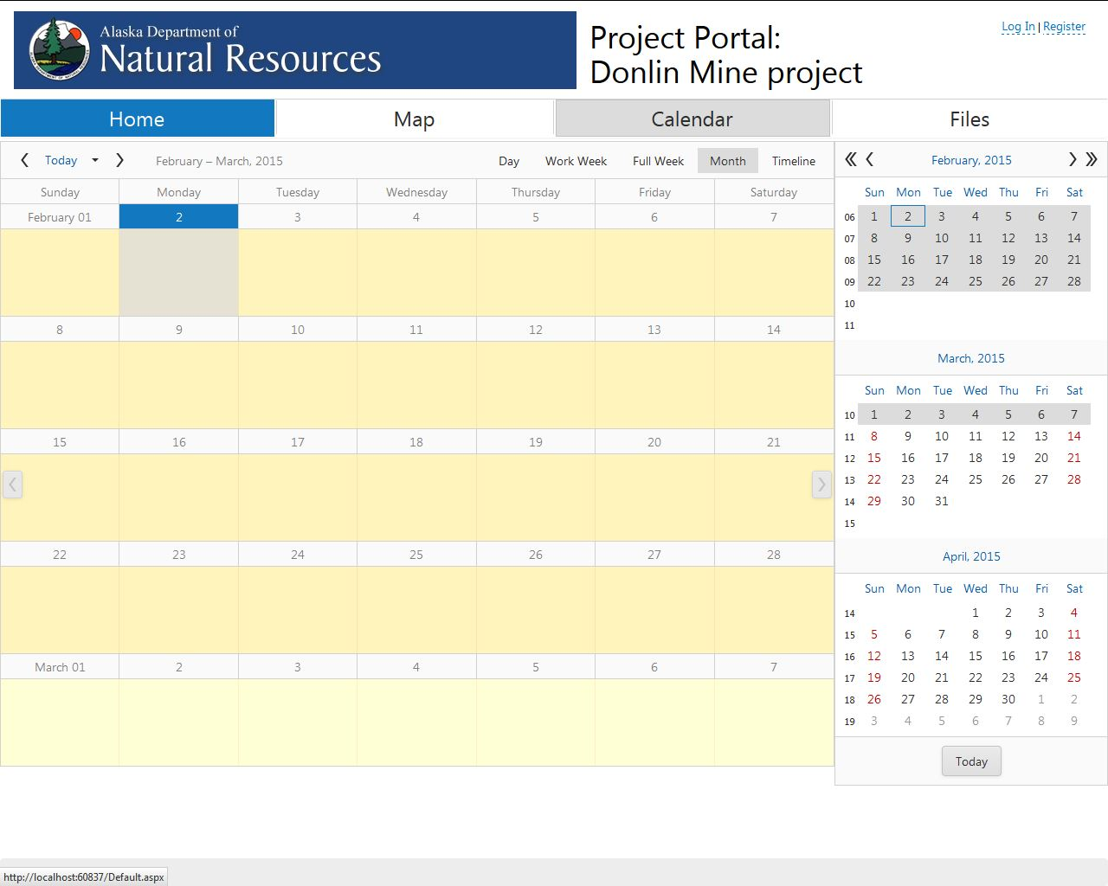

Slide 8
Files page
Display a file browser to display and manipulate files
Have the ability to upload and download files
Files will be stored on a file server

Slide 9
